Slide 1
Topic: Geometry
EQ: How do I draw a solid from different points of view?
EST content

Slide 2
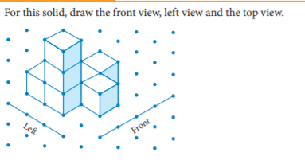
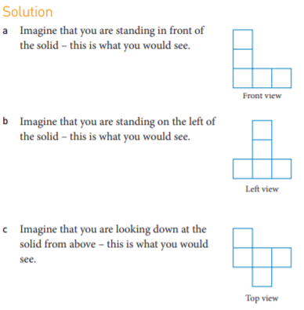
Example 1

Slide 3
How do I draw a solid from different points of view worksheet

